Slide 1

Interactive Data Visualization and
Storytelling

Slide 2

Objective
In today's world, where concerns about crime, public safety, and law enforcement practices are prominent
By analysing crime patterns and characteristics in Los Angeles:
Public Safety Concerns: Understanding crime patterns and trends is crucial for developing effective strategies to address public safety concerns and reduce crime rates.
Data-Driven Decision Making: analyzing large datasets such as crime data can provide actionable insights for improving law enforcement practices.
Relevance to Society: creating safer and more secure neighborhoods for everyone.

Slide 3

Goal
Public Safety and
Awareness
Crime types trend over time
Q: What is the crime rate trend? What are the top crimes?
Crime hotspot
Q. What are the most risky neighbourhoods?
vulnerable group
Q. What is victim sex and age range distribution?
high-crime time
Q. Which day of the week and what time of the day is less safe for residents?
Police Transparency and Accountability
Identifying Potential Bias
Q: Is there any bias regarding the police's claim of reducing crime reporting?
allocate resources more effectively by highlighting areas with higher crime rates or specific crime types.
Q. What is the most common crime in each neighbourhood?
making crime data readily available
visualize all data for the last 4 years in an interactive way.

Slide 4

Data
The Home of the U.S. Government's Open Data:
Official website of the United States government that provides encrypted and transmitted securely.
government data is required to be made available in open, machine-readable formats, while continuing to ensure privacy and security
290k+ DATASETS AVAILABLE
Records
926k
Features
28
Timeline
2020-2024
Location
Los Angeles
Datatypes
Cat/Num/Log/Datetime
Occurrence and reporting time: Creating a measure for calculating the time lag between occurrence and reporting
Location: Analyzing the distribution of crime occurrence using Lat and Long features
Demography features: Creating victim gender, race, age distribution
Crime type: Analyzing the most prominent crime type
The trend of crime over time: analyzing the crimes over time whether is increasing or decreasing.
Source: https://catalog.data.gov/dataset/crime-data-from-2020-to-present

Slide 5

Challenges
Large Dataset Size: Our dataset comprised approximately 1 million rows and 28 features, posing a significant challenge in terms of analysis and processing.
Data Cleaning Complexity: One of the major hurdles encountered was the necessity for extensive cleaning of the dataset. This involved rectifying inconsistencies, discrepancies, and errors present within the data.
Format Standardization: Many columns within the dataset were not in the desired format, requiring diligent efforts to ensure uniformity. This included converting data into appropriate formats for consistency and accuracy.
Creation of Calculated Fields: To enhance our visualizations and extract meaningful insights, we generated numerous calculated fields. These fields were tailored to meet specific analytical requirements, enabling us to delve deeper into the dataset.

Slide 6
Story
Understanding Historical Trends: Analyzing crime data from 2020 to present to identify recurring patterns and trends, providing insights into long-term shifts in criminal activity.
Uncovering Insights: Exploring the dataset to reveal crime hotspots, prevalent offenses, and temporal patterns, offering valuable context for strategic planning.
Informing Future Strategies: Equipping the police department with data-driven insights to formulate proactive strategies for crime prevention and intervention.
Collaborative Efforts: Emphasizing the importance of collaboration among law enforcement agencies, policymakers, and community stakeholders to develop holistic strategies addressing root causes of crime.
Notes:
2. "Investigating the dataset to find areas with a lot of crime, common types of crimes, and trends over time. This information can help plan strategies to address crime more effectively.“
3. "Using data to help the police plan ahead and stop crime before it happens.“
4. "Stressing how working together with police, lawmakers, and the community can help create better plans to stop crime by dealing with its main causes."

Slide 7
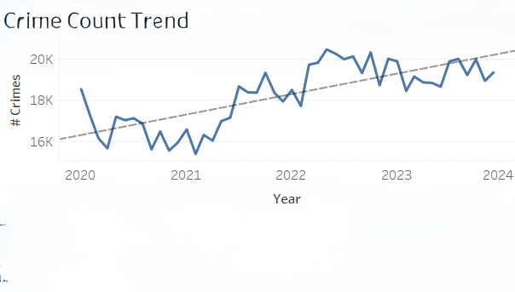
Time Analysis
Q. What is the crime trend over the years?
Looking at the Line Chart, we can clearly see the trend. It is depicting that our crime rate is increasing yearly from 2020 to 2024.

Slide 8
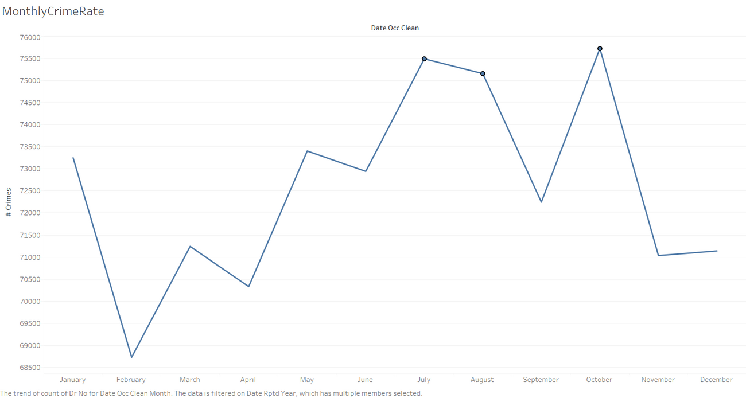
Time Analysis
Now that we understand the crime rate of yearly that it is increasing, Let’s see:
Q. What is the monthly crime rate?
Looking at the above Chart, we can see that the spikes highlighted are the months when the crime is at the most for all the years together.

Slide 9
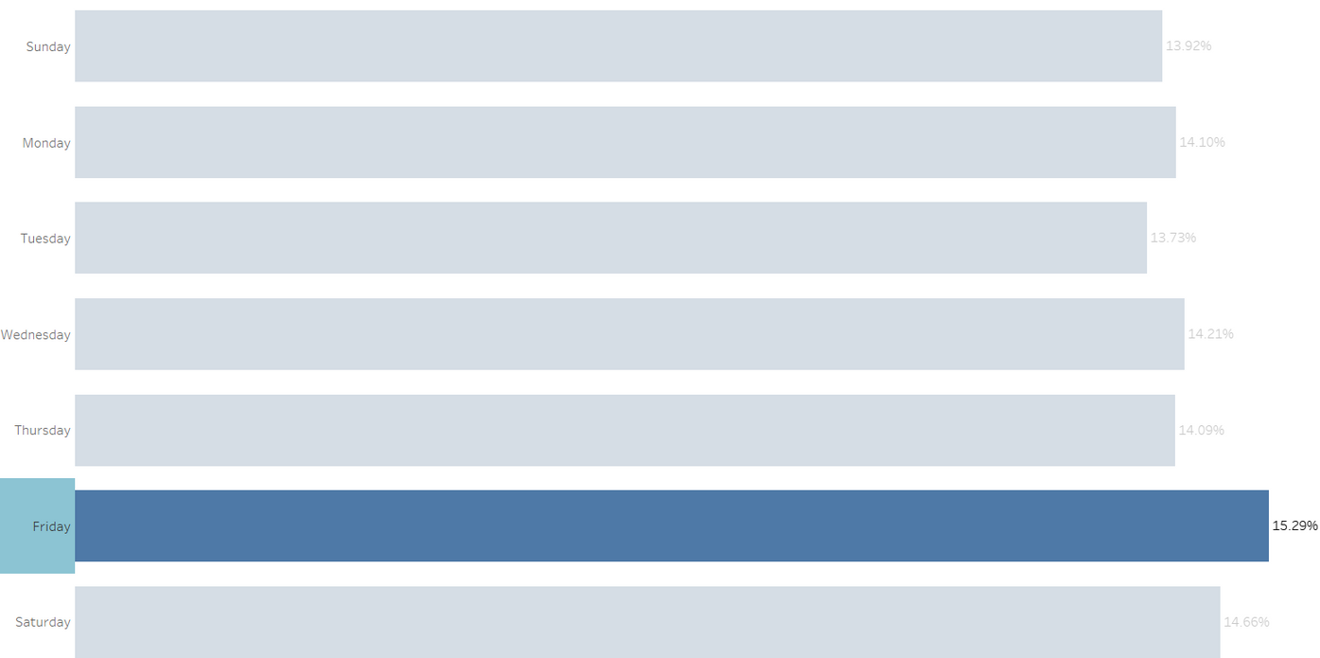
Time Analysis
We understand that the crime is increasing yearly and the most crimes happening is in October. Now, let’s dig more and find:
Q. What is the weekly crime rate?
Although, the number of crimes are almost equal on every day but still we can see more crimes on Friday as compared to other days.

Slide 10
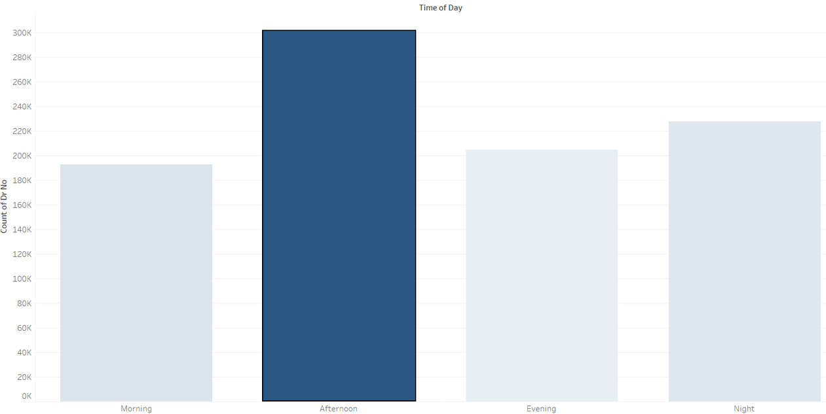
Time Analysis
After analyzing all this, Can we find any pattern which can help us analyze the crime trend? Let’s check:
Q. What is the daily crime rate?
Looking at this, we can clearly see that as compared to mornings, evenings and nights, the number of crimes are the most during Afternoons.

Slide 11
Time Analysis
Afternoon. If the crimes are happening the most in broad day light, a lot of more questions arise like why are these crimes not being controlled, what type of crimes could these be, where exactly all these crimes are happening, etc.
It is an interesting insight that the crime rates are increasing yearly, most of the crimes are happening in October, on Fridays and in broad daylight in Afternoons. As this dataset is real world dataset of Los Angeles city, after analyzing these insights and some more we can actually help solving these issues and can help finding the exact strategies we need to control all of these crimes.
Let’s Increase our horizon and get more deeper in the dataset to find answers and solutions for all the questions.

Slide 12
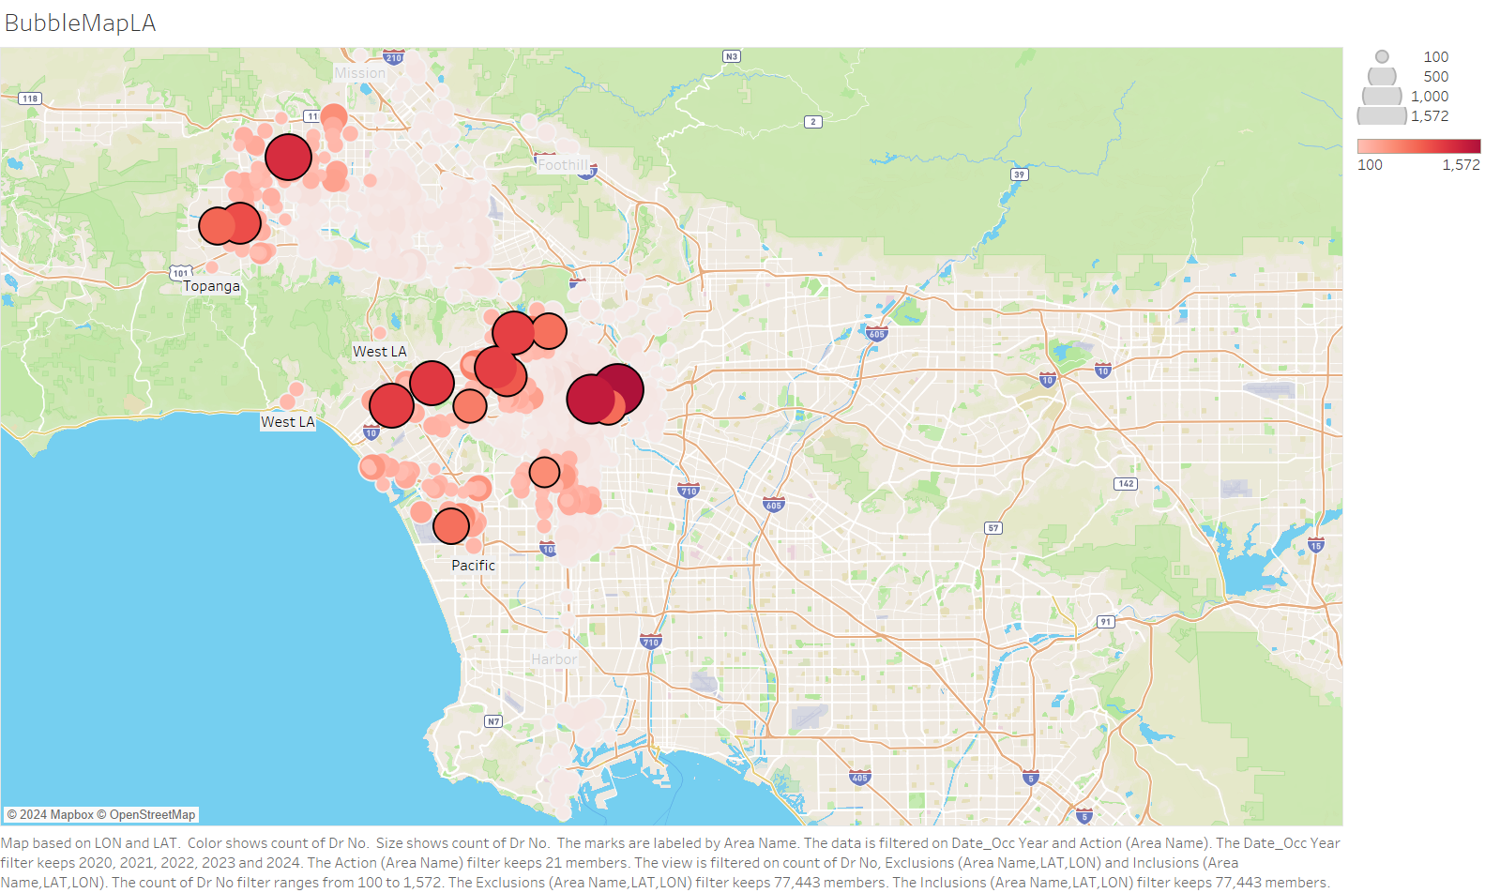
Crime Analysis
Q. Where all these crimes happening?
Here is the Los Angeles Map. We made a Bubble Chart which shows the crime distribution over the Los Angeles. We highlighted some of the areas which are the hotspots where the crimes are happening more as compared to other areas.

Slide 13
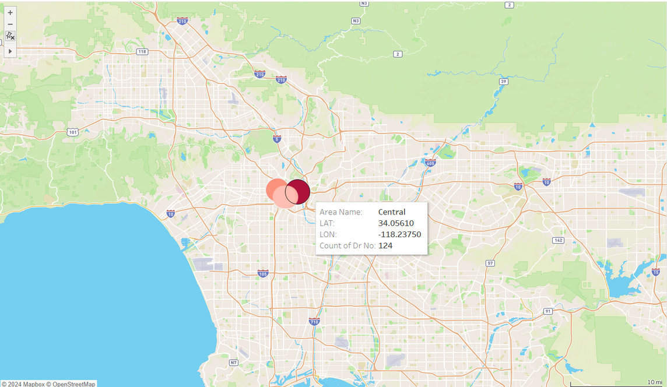
Crime Analysis
The previous chart shows the distribution of the crimes in LA neatly but, as we figured this that in October the crime rate is higher so let’s only check this month and figure out:
Q. Which area is most affected during the month of October?
In this visualization, we added filter on October month and found that the most affected area during this time period in Los Angeles is ‘Central’.

Slide 14
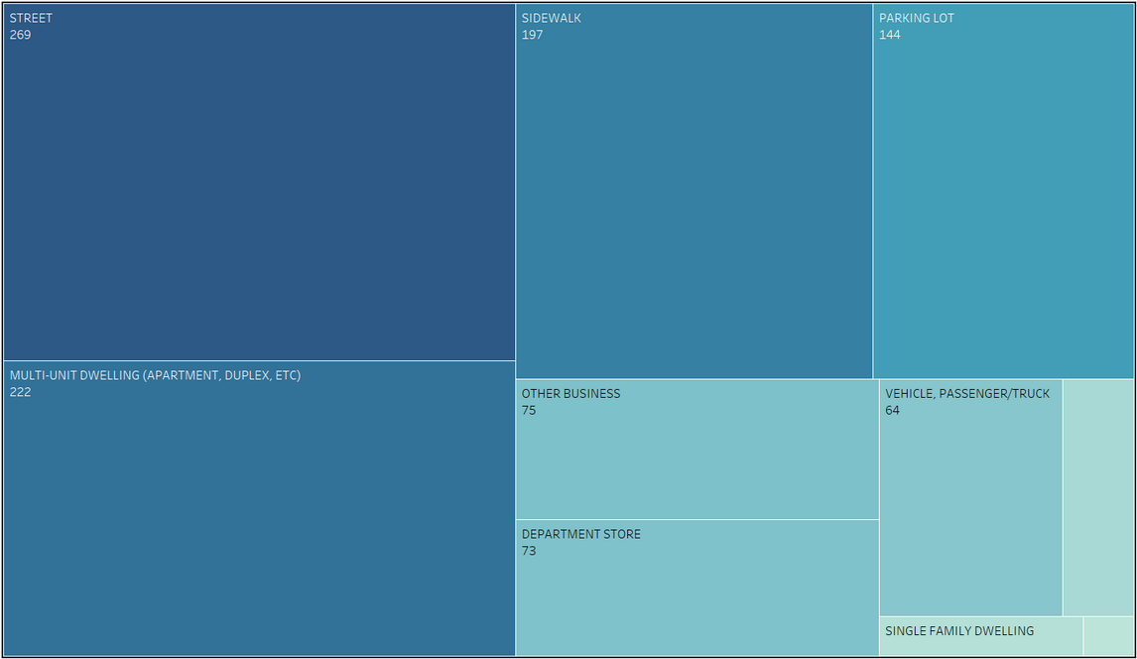
Crime Analysis
We need to dig more to find out why the crime rate in Central during this particular time period is the highest. Let’s figure out:
Q. Which premises are most affected?
Clearly, we can tell that most of the crimes are happening on ‘Street’ followed by ‘Multi-Unit Dwelling’ and ‘Sidewalk’.

Slide 15
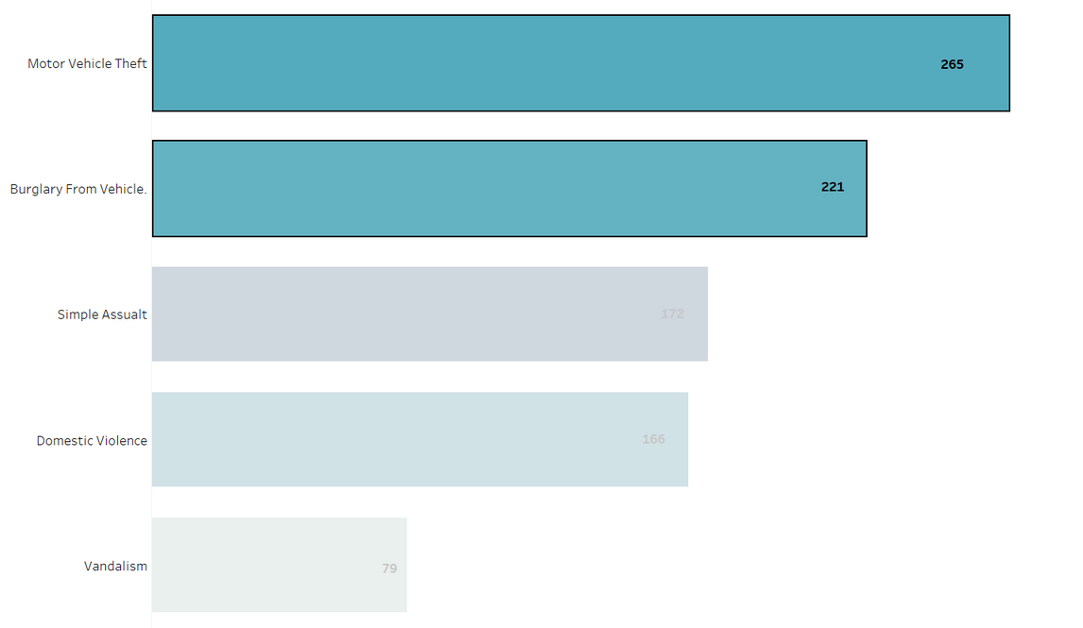
Crime Analysis
If the crimes are happening on street the most then these crimes could be car robbery, accidents, etc. Let’s see:
Q. What are the top 5 crimes?
By looking at these top 5 crimes we can narrow it more down by highlighting the top 2 crimes because there is a significant difference from bottom three. motor vehicle theft and Burglary from vehicle, are the hot crimes.

Slide 16
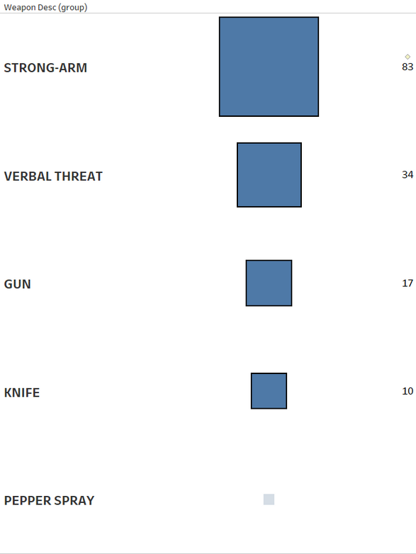
Crime Analysis
It’s again an interesting insight we found. We should analyze it further to give any solution or decision based on these insights. Now, let’s find:
Q. What top 6 weapons were used?
By looking at these top 6 weapons used, we found that top mediums used to make a crime happening are bare hands, verbal threat, knife and gun contains most of the distribution.

Slide 17
Crime Analysis
Is this pattern making sense now, can we make any statement and make some strategies to figure out how to control the crime rate.
Yes, Now we understand the reason, cause, location, etc. This information is enough to make strategies to control the crime rate and we can make some statements.
But, we do still have some insights which we can explore to figure out the biases in the crime rates. We can also analyze these to check if our dataset provides any evidence to support any theory or not.
So before making any statement, let’s try to find some more insights.

Slide 18
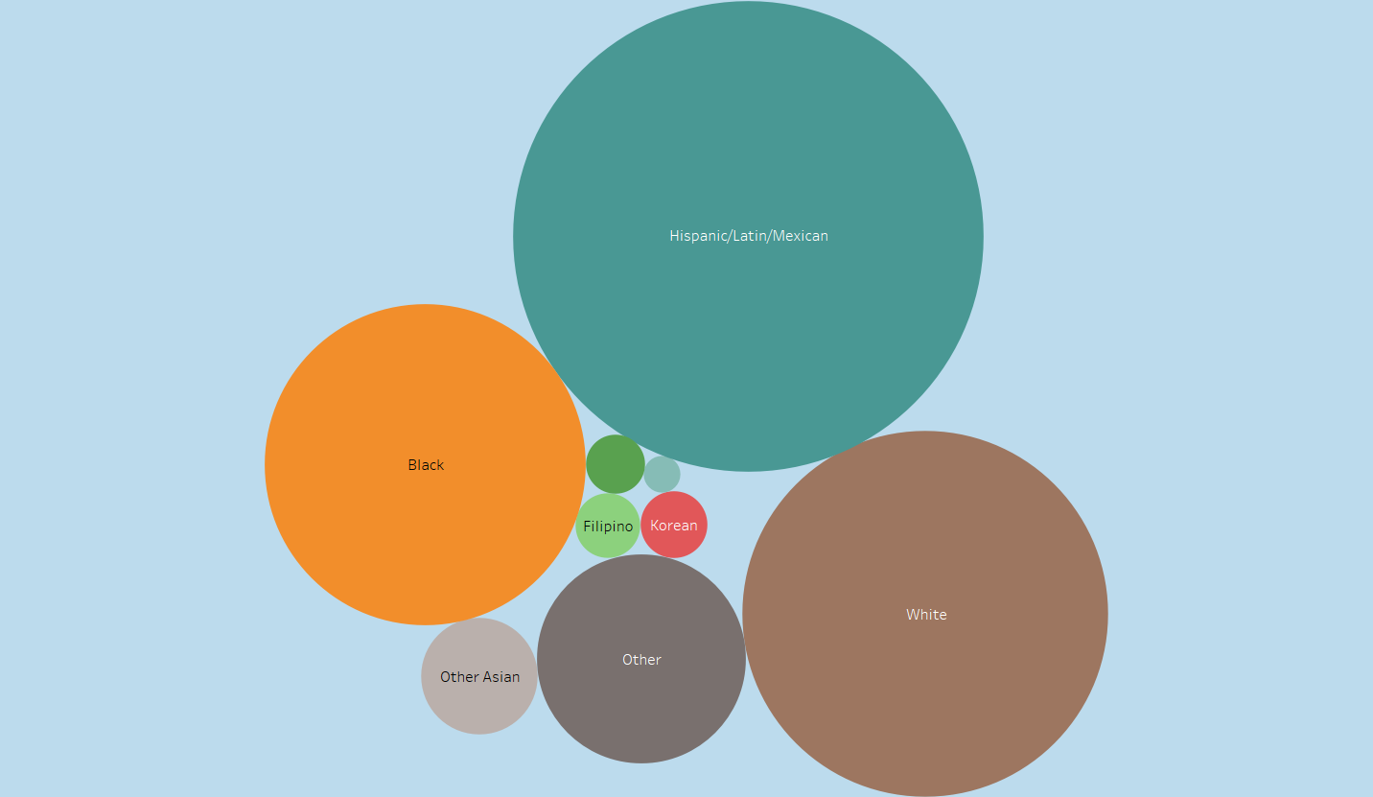
Race Distribution
Here is a Bubble Chart showing us the distribution of the victims’ race.
Could there be any link with race causing increase in the number of crimes?

Slide 19
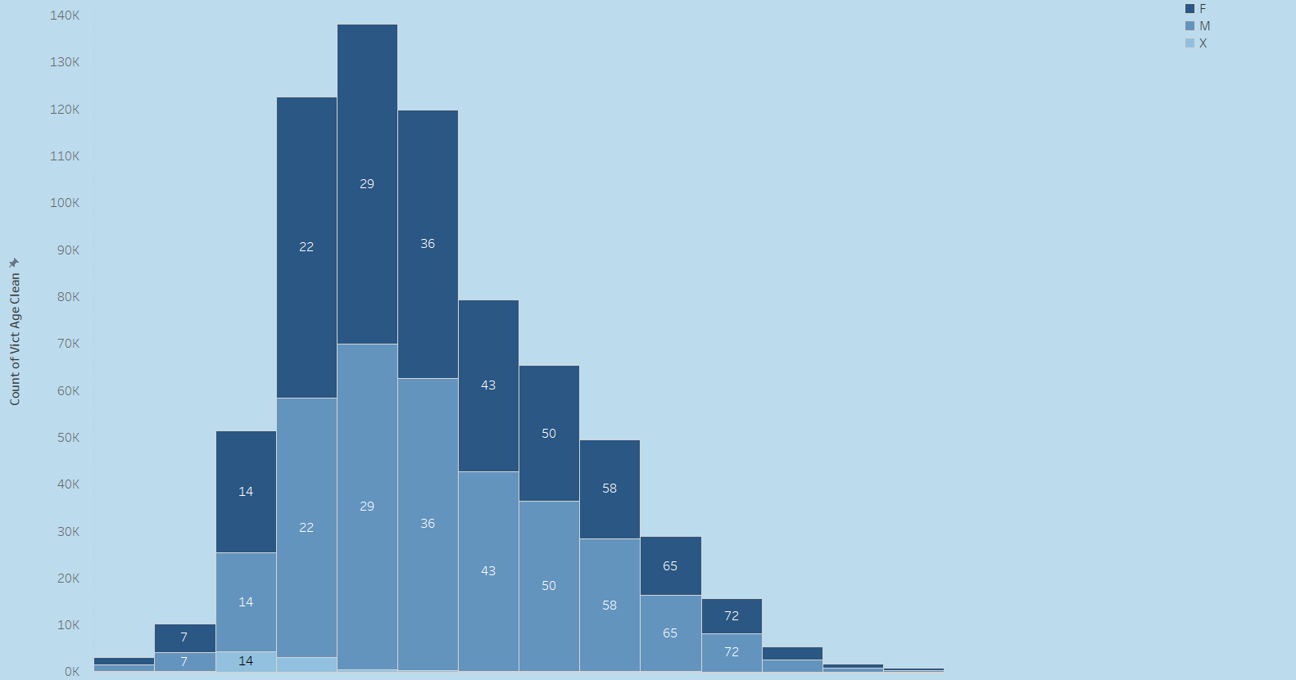
Age Distribution
Here is a Histogram which is showing the distribution of the victims’ sex.
Could there be any link with victim’s sex causing increase in the number of crimes?

Slide 20
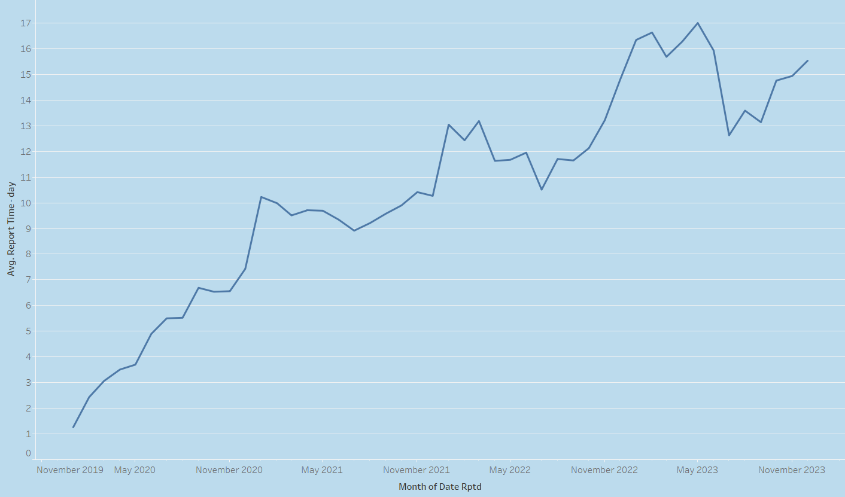
Delay in Reporting Time
Here is a line chart showing the delay in the reporting time in days. Basically, how much time the victim is taking to report a particular crime after it happened. We also have some cases where the crime was reported before it occurred and it is possible as sometimes a person can report in case he thinks he is in danger.
But the most interesting point to make here with this chart is that the time gap is increasing over the time which should not happen because it shows that the victims are afraid to report or maybe loosing their faith causing high reporting time gap.

Slide 21
Summering Analysis
We are done with deriving insights and patterns from our data. As we explored almost everything we could from the data. Let’s start analyzing the output now.
Time Analysis: We can make this certain statement that the most of the crime happening over the years is in ‘October’ month and can see an ‘increase’ trend. The week day is ‘Friday’ and specifically the time of the day for most crimes is ‘Afternoon’.
Crime Analysis: We also can make the statement that the most of the crimes in Los Angeles is happening in the Area ‘Central’. Additionally, these are happening on ‘street’ with ‘bare hands’, ‘verbal’ and ‘gun’.
Supporting Analysis: We surely made two statements in above analyses. About the extra analysis we did:
Race Distribution: It is clearly visible that some races are in majority which shows that the crime happening are actually happening in majority of those races. But we still cannot make a correct statement here because it is fine if the population of all of the races are equal but in case it is not equal then we will have to normalize the data first before making any statement. For now as we do not have population in our data we should drop this claim.
Age Distribution: Looking at the Distribution of age we can derive information that most of the crimes happening are in the age group of 20-30. Looking at the gender we can see that majority of our victims are female. This insight could be more useful. looking at the crimes, domestic violence was one of the top crime too so this representation does makes sense too and it can be useful for further analysis.
Reporting Time Analysis: Looking at this chart, we can clearly see that reporting time is increasing. which means people are reporting the crime late and it is increasing over the years. we cannot tell the reason but it creates another question: Does people of Los Angeles does not have enough faith in LAPD, Why would they not report the crime happend instantly or take much time.

Slide 22
Conclusion
By looking at the increase in the crime rates over the years, it is clear that LAPD can make some strategies which can help in reducing these crimes. LAPD actually made a strategic plan for 2021-2023 (Source).
Looking at this, LAPD actually did it for these 6 reasons:
Protecting and engaging the people of Los Angeles to reduce overall crime.
Improving organizational accountability.
Integrating advanced technology for effective patrol performance
Developing Departmental readiness for critical incidents through enriched training.
Maximizing workforce potential through career development and increased diversity recruitment.
If we go through these strategies, we can see that a lot of investments and claims are being made by the LAPD. We are not stating anything but looking at the real data of the crime trends, we can surely state one thing for sure that all these strategies and investments are not helping for sure. As neither the crimes are decreasing nor they are the same. Also, the population of LA actually decreased from 2020 to 2024 so the trend we saw in the charts actually true.
According to the analysis we made, for example they can see the trend that the crime is most in afternoons for specific crimes and in which month of the year, etc they can actually make strategies like increasing the patrol in that particular area (central) in a specific day and time. Also, they can look with extra data that why the crimes are most in a specific Race, specific gender or why 20-30 group is the most as the victims.

Slide 23


